Slide 1
Volumetric fetal brain study in twins with severe discordancy using semiautomatic 3D MR imaging measurements
Student: Tom Halevy
Mentor – Dr. Eldad Katorza

Slide 2
Fetal brain MRI
PubMed search of ‘fetal MRI’ yields 6,346 references (Dec 2017), of which 2,667 include 'fetal brain MRI’.
Indications for fetal brain MRI:
  History of sever brain abnormality in previous pregnancy but normal US scan.
  An isolated abnormality found on US scan.
  Abnormality on US, but scan can’t be complete due to technical difficulties.
  High risk of development of brain abnormality, especially in cases of fetal infection.
Timing:
  Beginning of third trimester (28-32 weeks) is preferred.
Notes:
An isolated abnormality found on US scan, is there any additional abnormality that was missed?

Slide 3
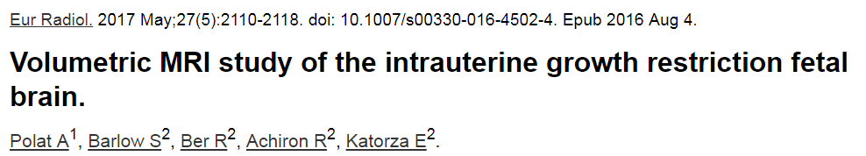
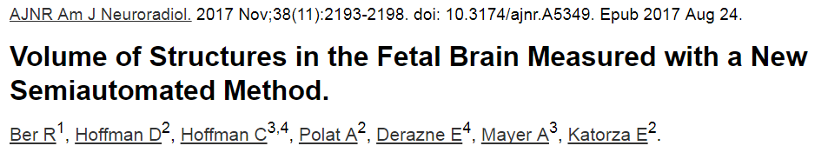
3D volumetric assessment of the fetal brain
  Evaluation of regional brain volumes differences in IUGR.
  Cerebellar to supratentorial brain volume ratios were smaller in IUGR fetuses.
  What is the long term effect?
  Good to excellent intraobserver agreement.
  Semiautomated results are not inferior to manual technic and are less time consuming and user dependent.
Notes:
‘Volumetric MRI study of the IUGR fetal brain’ – singleton pregnancy.

Slide 4
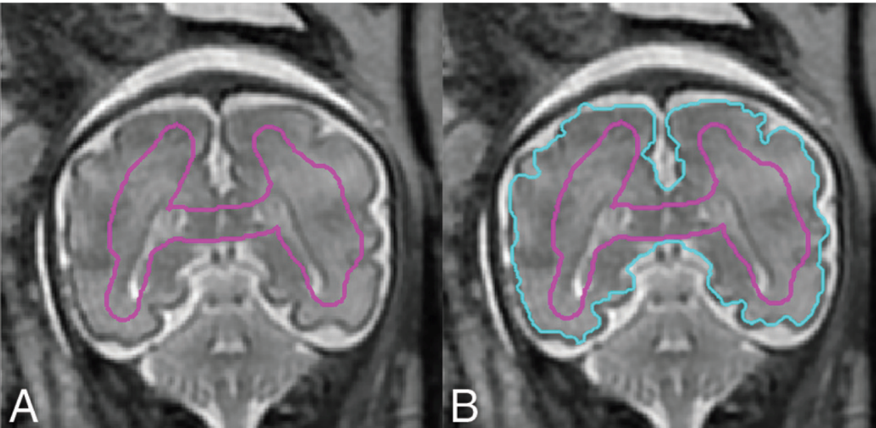
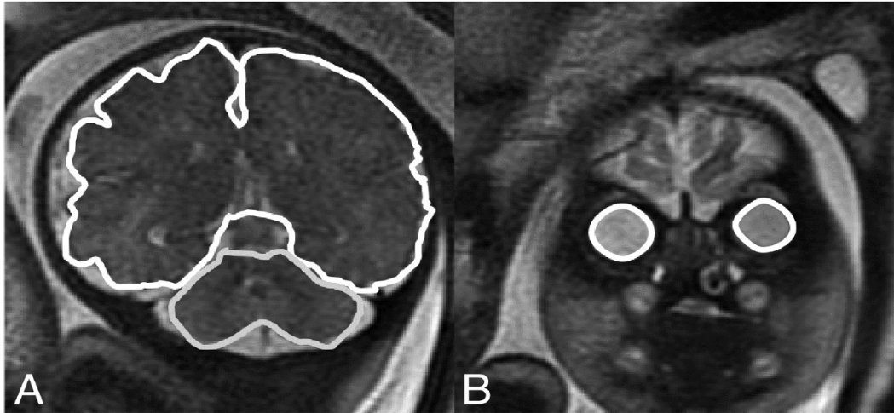
Semiautomated measurement
Retrospective coronal section measurements of the following volumes will be obtained:
  Supratentorial brain
  Left and right hemispheres
  Cerebellum
  Left and right eyeballs

Slide 5
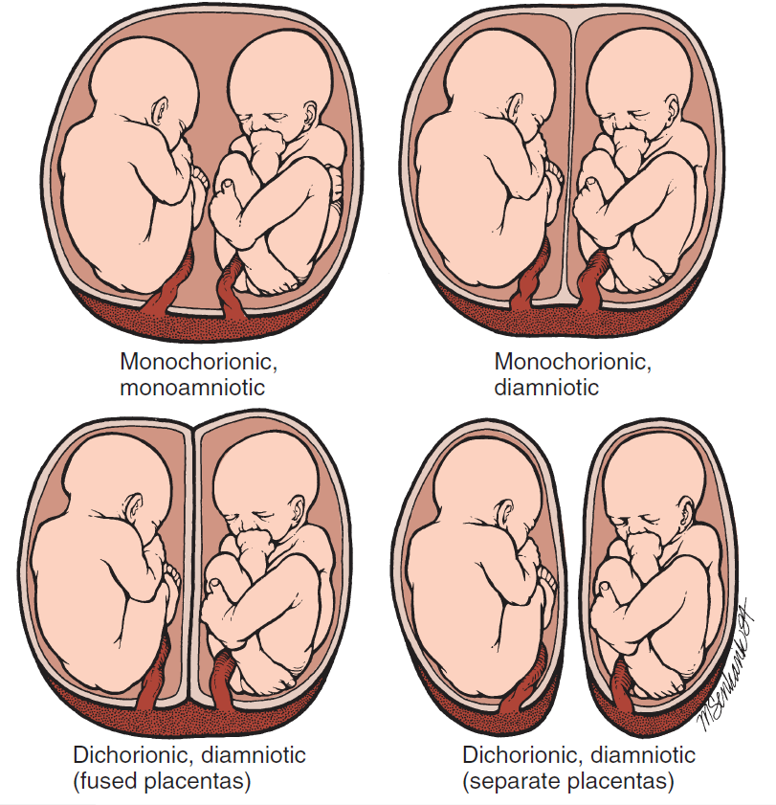
Twins BABC MCBA
MCBA
BCBA

Slide 6
Discordancy/sIUGR
Discordance – when anomaly is detected in a twin gestation the co-twin is usually normal.
  In growth, this is defined by difference in weight grater than 20% of actual or estimated weight.
sIUGR – estimated fetal weight < 10th percentile of one twin with adequate for gestational age co-twin.
10 – 15% of MCBA twins but also present in BCBA pregnancies.
Notes:
Discordance – in DZ twins, the genetic distinction may lead to different weight → pathologic situation still exsist in the form of TTTS only in mono, umbelical cord abnormalities that affect only one fetus, and sIUGR.
By it self discordance is argued not to be a concern if the EFW is in AGA of both fetus but if sever it can suggest on possible clnically significant growth restrication. The exact nuimber that should be used as an increased risk is under debate.

Slide 7
Research questions
  Is there difference in brain volumes between the twins with severe discordancy/sIUGR that are measured by MRI?
  Is there difference in brain volumes comparing to the whole body weight discordancy?
  Is there difference in the outcome which correlate to above?
  Is there differences in the discordancy patterns between BCBA to MCBA twins ?
Notes:
יש סוגיה לגבי האווטקאם הניורולוגי של העוברים, כאשר ההערכה הרווחת היא שככל שהדיסקורדנס גדול יותר – צפויה בעיה ניורולוגית בעובר הקטן.
מעבר למטרת המחקר, יש שאלה האם הדיסקורדנס המתבטא במשקל הגוף מתבטא גם בנפחי המוח בהתאם ומה האווטקאם הניורולוגי.

Slide 8
Neurodevelopment
Follow up will be done using VINELAND questioners.
The Vineland-3 is a standardized measure of adaptive behavior.
Focuses on what the examinee’s actually does in daily life.
Adaptive functioning is compared to that of others his or her age.
ABC score is based on scores for three specific adaptive behavior domains:
  Communication
  Daily Living Skills
  Socialization
Notes:
Adaptive behavior → the things that people do to function in their everyday lives.
Communication domain measures how well Jordan listens and understands, expresses himself through speech, and reads and writes.
The Daily Living Skills domain assesses examinee’s performance of the practical, everyday tasks of living that are appropriate in the school setting.
Socialization domain reflects his functioning in social situations

Slide 9
Materials and methods
Data collection of 18 pairs of MCBA and 15 pairs of BCBA.
  MRI scans
  Antenatal complications
  Mode of delivery
  Birth weight
  Dolberg percentile
  Appgar score
Assessment of brain volumes
  Analysis by Matlab-based semiautomated software.
Performing Vineland’s questioners.

Slide 10
References
Salomon, L.J. & Garel, C., 2007. Magnetic resonance imaging examination of the fetal brain. Ultrasound in Obstetrics and Gynecology, 30(7), pp.1019–1032.
Gabbe, S., 2016. Obstetrics : normal and problem pregnancies 7th ed., Elsevier.
Ber, R. et al., 2017. Volume of Structures in the Fetal Brain Measured with a New Semiautomated Method. American Journal of Neuroradiology, 38(11), pp.2193–2198.
Polat, A. et al., 2017. Volumetric MRI study of the intrauterine growth restriction fetal brain. European radiology, 27(5), pp.2110–2118.

Slide 11
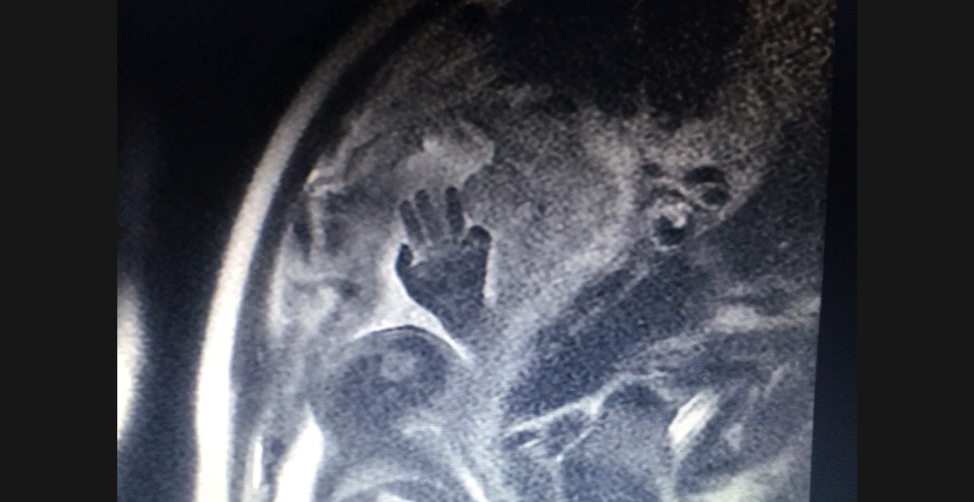
Questions?
Thank you

